Slide 2
Housing Prices – Multivariable Regression
Cameron Jamieson, Khoa Bui

Slide 3
Project Description
Given certain qualities of a house, predict the sale price
https://www.kaggle.com/competitions/house-prices-advanced-regression-techniques/data
79 explanatory variables
Relevant issue in the real estate market
What would your house sell for/getting a fair price?

Slide 4
Approach/Implementation
Python
Sklearn
Pandas
80-20 test/train split
Cross-Validation – in progress
Trim based on P-Values – in progress

Slide 5
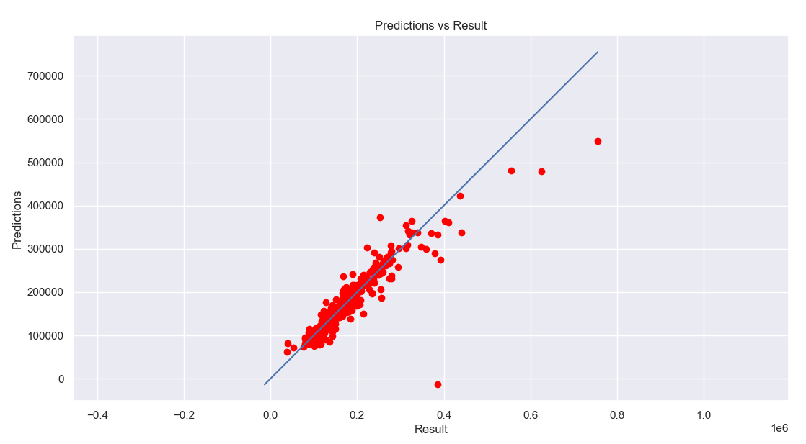
Current Results

Slide 6
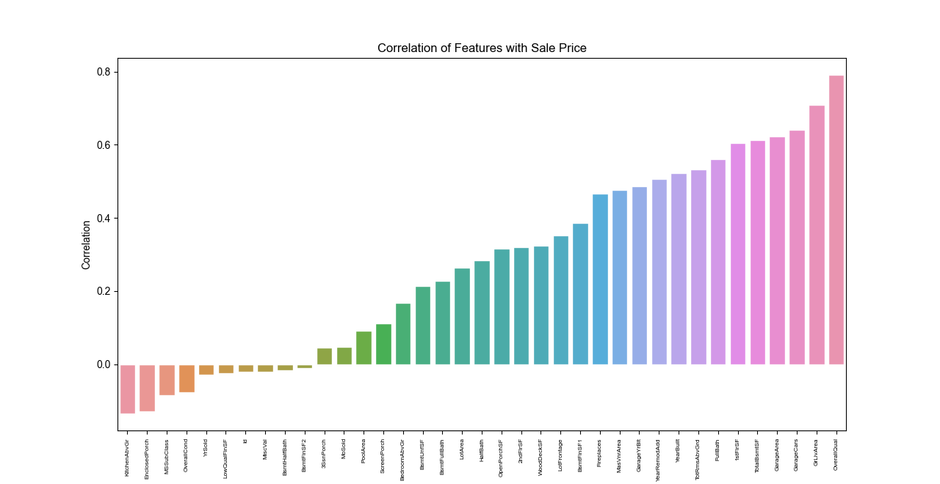
Current Results

Slide 7
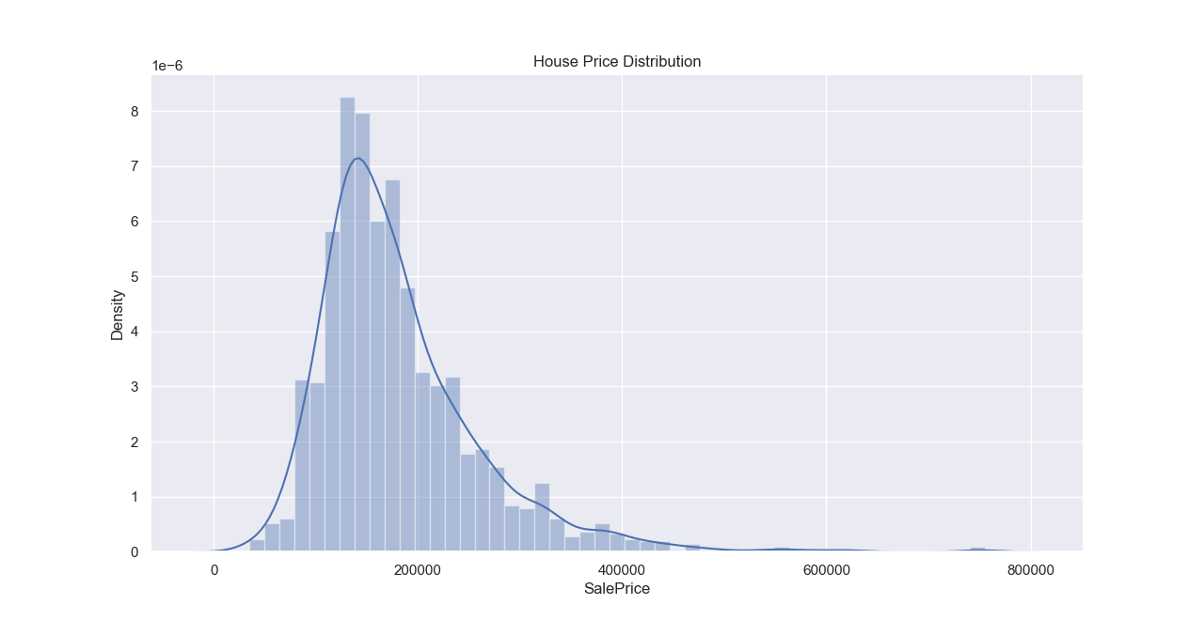
Current Results

Slide 8
Related Work
https://ieeexplore.ieee.org/document/8882834
https://scholarworks.calstate.edu/downloads/dj52w646n

Slide 9
Bibliography
Montoya, A. (2016). House prices - advanced regression techniques. Kaggle. Retrieved December 3, 2022, from https://www.kaggle.com/competitions/house-prices-advanced-regression-techniques/overview
C. R. Madhuri, G. Anuradha and M. V. Pujitha, "House Price Prediction Using Regression Techniques: A Comparative Study," 2019 International Conference on Smart Structures and Systems (ICSSS), 2019, pp. 1-5, doi: 10.1109/ICSSS.2019.8882834.
Yuan, L. (2109). (rep.). A REGRESSION MODEL OF SINGLE HOUSE PRICE IN LA CONSTRUCTING A PREDICTED MODEL FOR HOUSE PRICES (pp. 1–13). Pomona, California: California State Polytechnic University.

Slide 10
Bibliography
Montoya, A. (2016). House prices - advanced regression techniques. Kaggle. Retrieved December 3, 2022, from https://www.kaggle.com/competitions/house-prices-advanced-regression-techniques/overview

